Slide 1


Welcome to the Exciting World of Software Engineering Research
A Birds Eye view of the research we do!

Slide 2
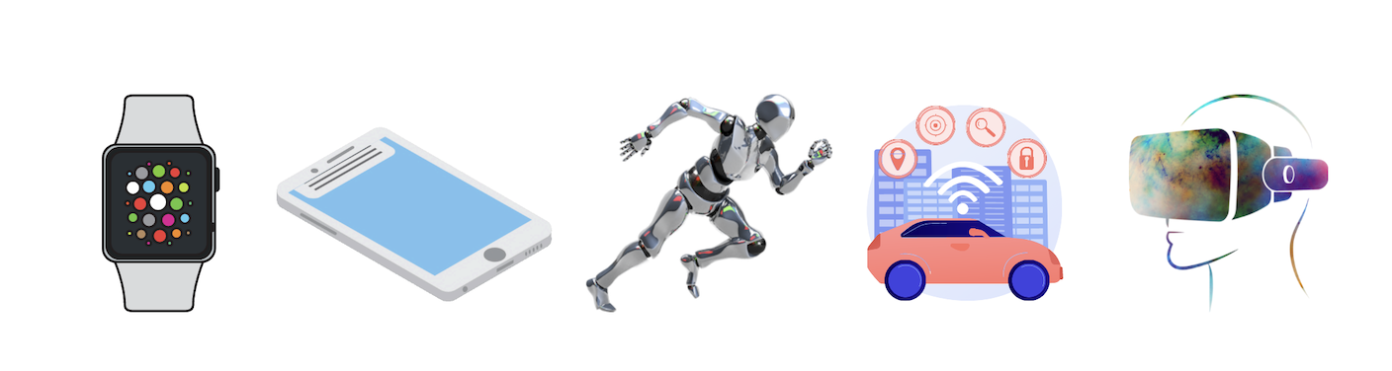
Why SE research? – In a world of Software
Improving SE Practice – Research holds the key!!!
Some interesting and important facts!!
About 70% of the cost goes for software maintainence
Modern car runs 100 million lines of code - Only going to increase!
By 2025, we will have 27 billion connected IoT devices
Tesla car crashes in autopilot mode, AI sending wrong people to jail!
Source: ieee spectrum, iot anlaytics

Slide 3
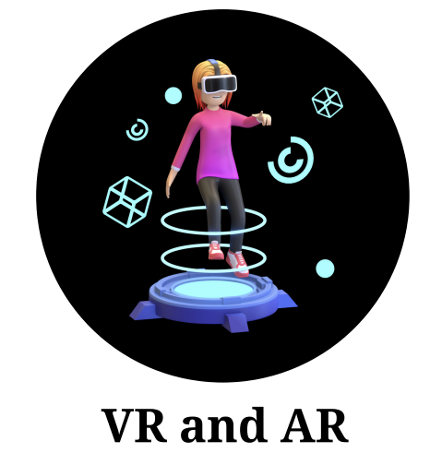
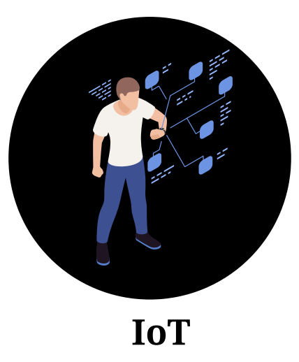

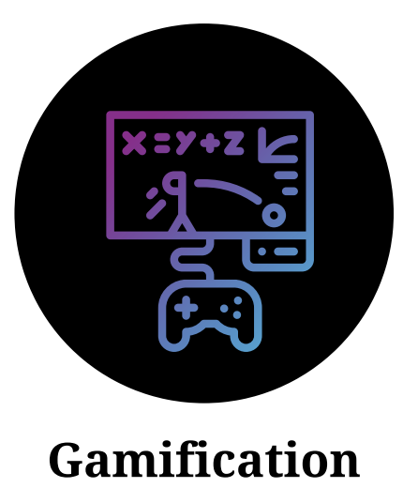
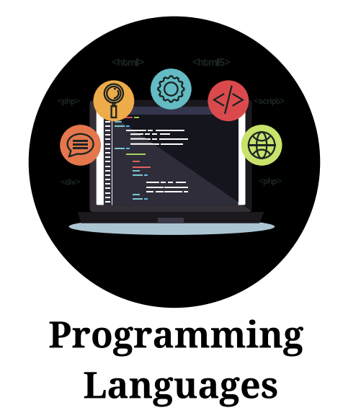
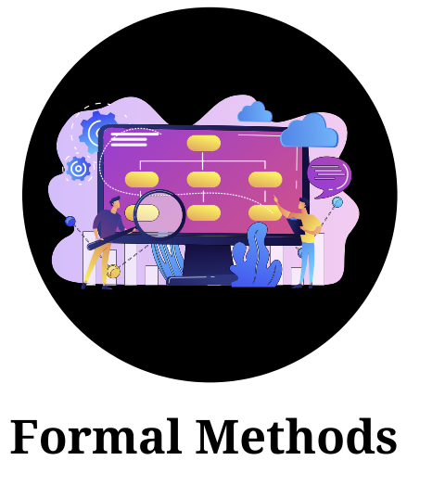
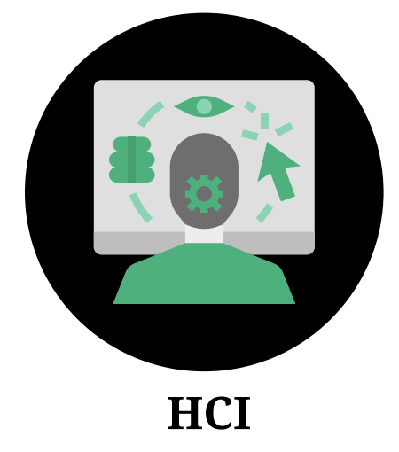


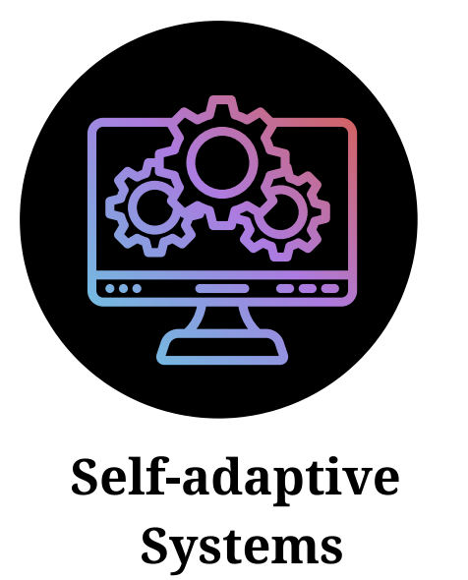
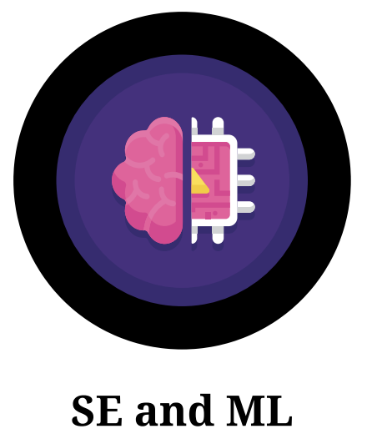

What we do? - Research Areas in SERC
Notes:
Patent related to usability – quality
People part of working groups beureu of information standards
Add knowledge engineering – Work on ontologies – Developed a security search engine developed in regard to this – Funded projects – US Patent
Meity project
MHRD
One of the largest projects with millon of users
HCI – Considering metaverse. We need to look at human behaviours so that we can deliver interaction models that can deliver
Programming Languages – reason about the program. How do you reason about the program?
Principles of programming languages – what makes function work?
Prove correctness of programs,
Design domain specific langauges, better represent programs and also better enable students to learn programming languages
Systems intereact

Slide 4
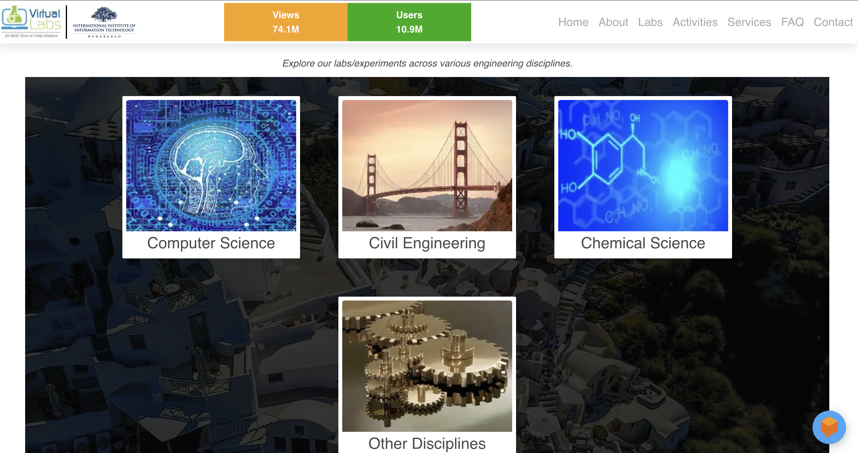
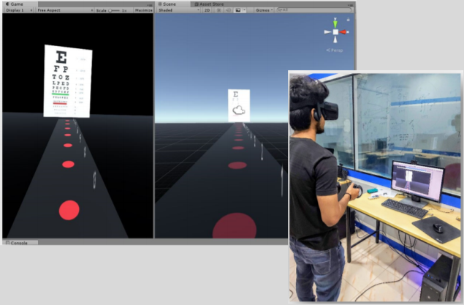
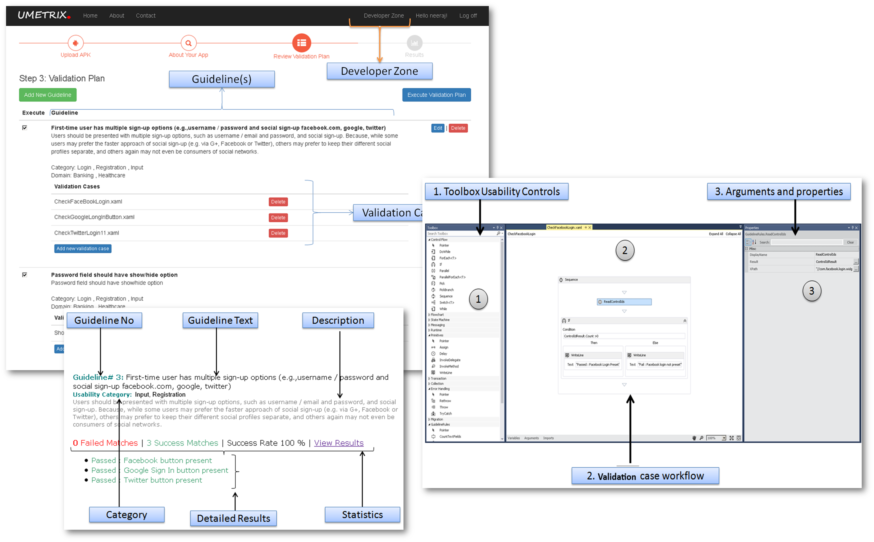
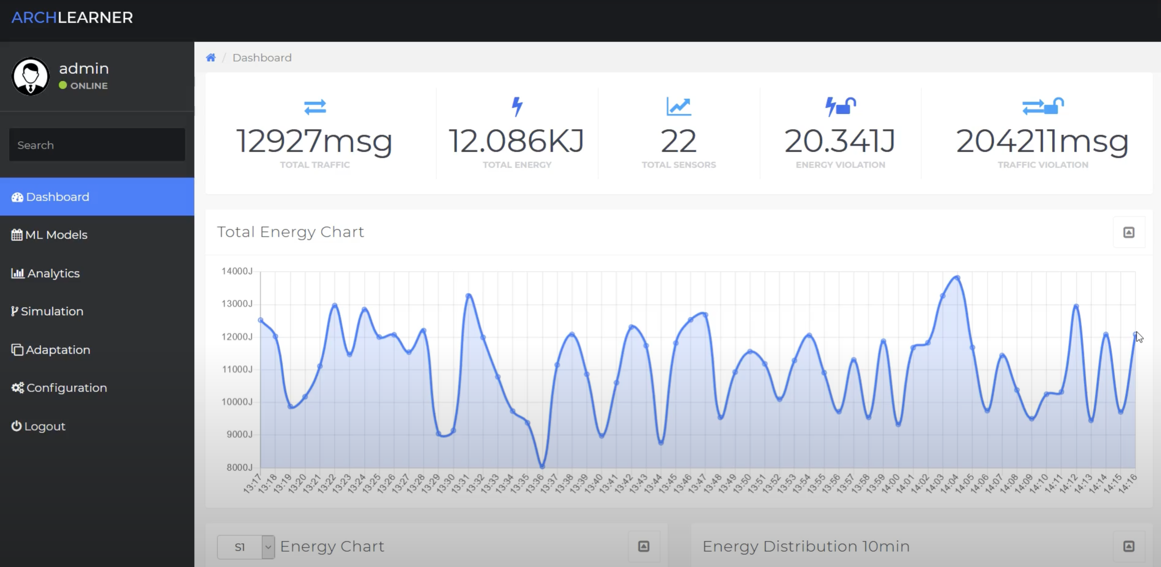
What we do? – Glimpses of Research Outcomes
Virtual labs – 10M users, 70M Views
VR Eye – VR for healthcare
UMetrix – Usability Metrics [US Patent]
Archlearner – Optimizing Energy

Slide 5
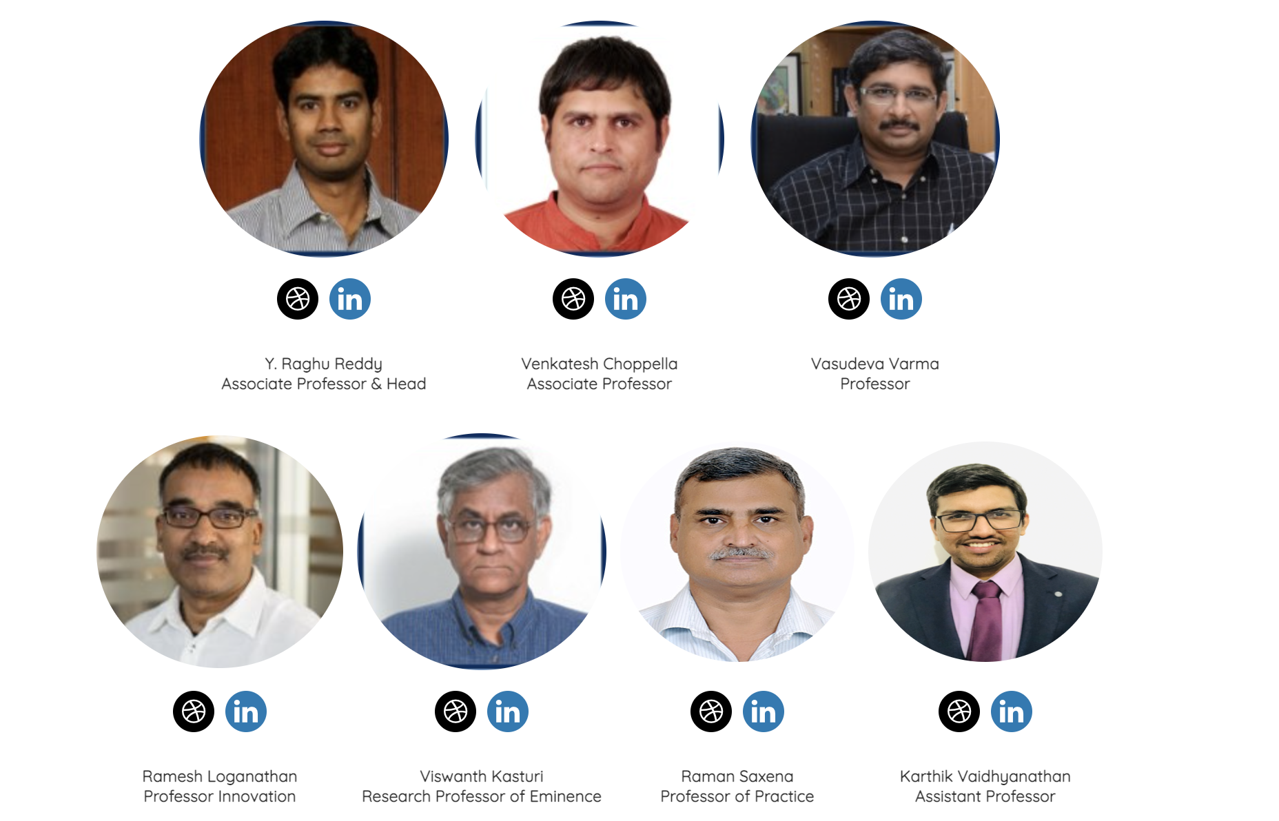
Faculty Team
Notes:
Ramesh partially here and partially CIE

Slide 6
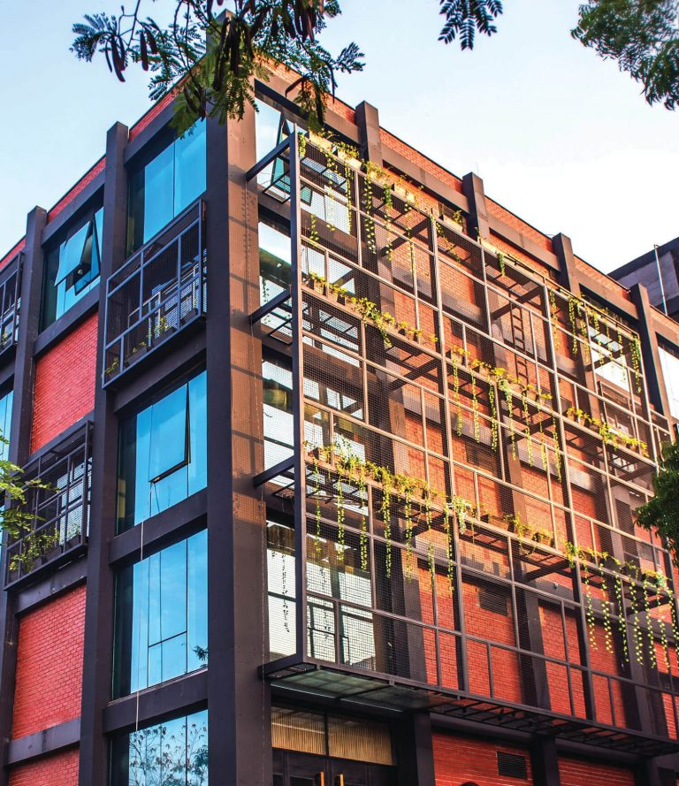
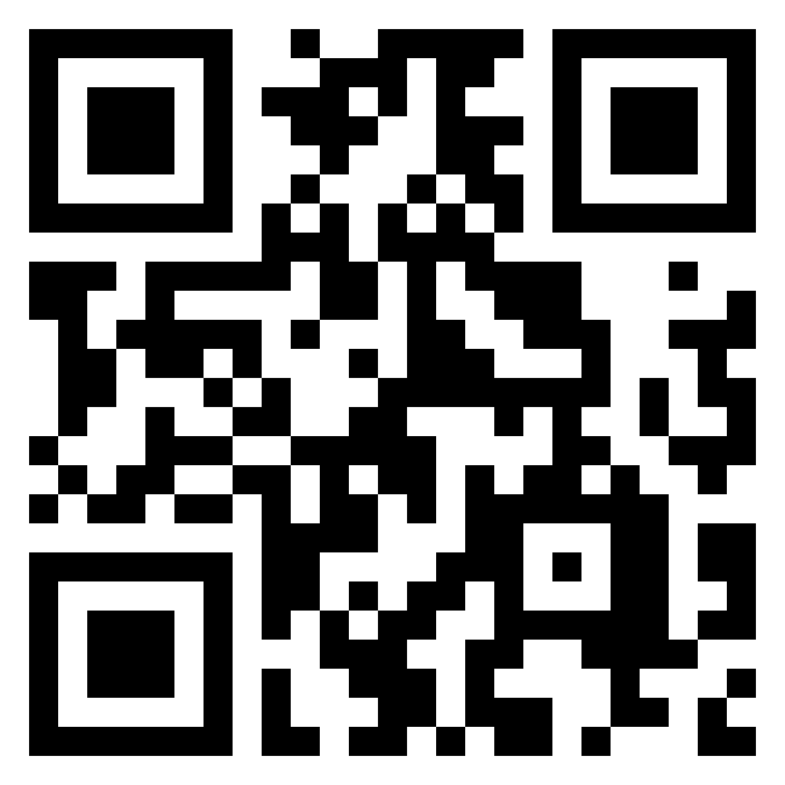


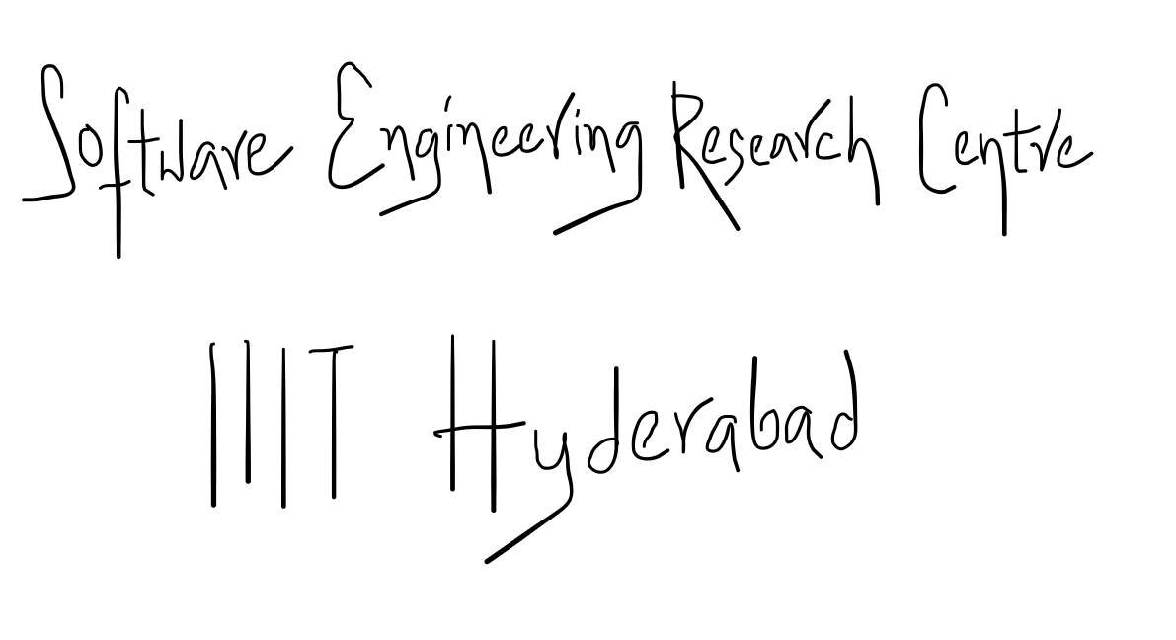
How to get Started?
Visit us:
SERC, 5th Floor, Old T-Hub Building
Officially: Himalaya Block-D
Follow us
Write to us:
raghu.reddy@iiit.ac.in
Connect with us in LinkedIn
@SERC_IIITH
Visit our website

Slide 7
Thank you

